Slide 1
Capstone Engagement
Assessment, Analysis, and Hardening of a Vulnerable System

Slide 2
Table of Contents
This document contains the following sections:
01
Network Topology
02
Red Team: Security Assessment
03
Blue Team: Log Analysis and Attack Characterization
Hardening: Proposed Alarms and Mitigation Strategies
04

Slide 3
Network Topology
3

Slide 4
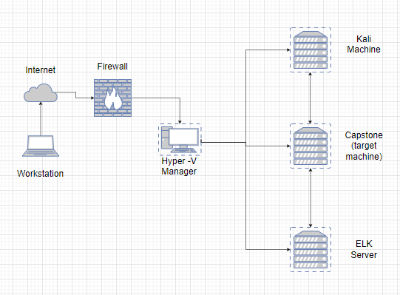
Network Topology
Network
Address Range: 192.168.1.0/24
Netmask: 255.255.255.0
Gateway: 10.0.0.1
Machines
IPv4: 192.168.1.1
OS: Windows
Hostname: Hyper-V Manager
IPv4: 192.168.1.90
OS: Linux
Hostname: Kali
IPv4: 192.168.1.105
OS: Linux
Hostname: Capstone
IPv4: 192.168.1.100
OS: Linux
Hostname: ELK

Slide 5

Red Team
Security Assessment
5

Slide 6
Recon: Describing the Target
Nmap identified the following hosts on the network:
Hostname | IP Address | Role on Network
Hyper-V Manager | 192.168.1.1 | Manages multiple virtual machines
ELK | 192.168.1.100 | Contains ELK Server that captures logs of network activity
Capstone | 192.168.1.105 | The target machine
Kali | 192.168.1.90 | The attacking machine

Slide 7
Vulnerability Assessment
The assessment uncovered the following critical vulnerabilities in the target:
Vulnerability | Description | Impact
Open Port 80 | Port 80 is commonly used internet communication protocol, Hypertext Transfer Protocol (HTTP). | After seeing the open port, I was able to access the company’s directory via web browser
Directory Traversal | HTTP attack that allows attackers to access restricted directories | I was able to access the company’s secret directory from the URL
Brute-Force Attack | A brute force attack is a hacking method that uses word lists of leaked or common passwords and systematically attempts to crack passwords, login credentials, and encryption keys | I was able to crack Ashton’s password using Hydra, and Ryan’s hash using CrackStation
WebDav Vulnerability | WebDAV is an extension to the HTTP protocol that allows users to upload, move or change the documents on the server | After gaining access to the system via Ashton’s and Ryan’s passwords, I was able to access the company’s WebDav and upload a malicious php script
Reverse Shell | Reverse shell is a kind of “virtual” shell that is initiated from a victim's computer to connect with the attacker's computer. Once the connection is established, it allows the attacker to send over commands to execute on the victim's computer and exfiltrate information. | After the malicious php script, that was uploaded via WebDav, was clicked, I was able to open a reverse shell from the target machine to the kali machine. I was able to remotely find the flag

Slide 8
Exploitation: Open Port 80
01
02
Tools & Processes
I used nmap to scan for IPs and open ports.
I saw that Port 80 (HTTP) was open for 192.168.1.105
Achievements
I was able to access the company directory via browser
From the URL, I was able to access “192.168.1.105/company_folders/”

Slide 9
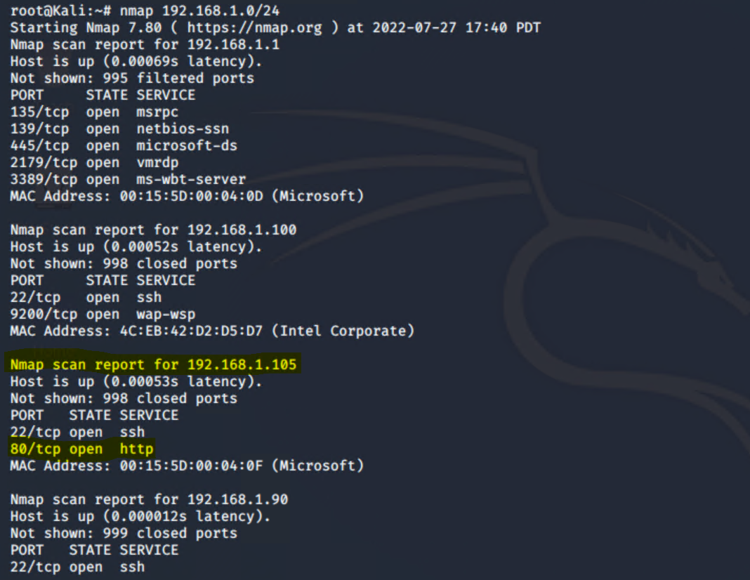
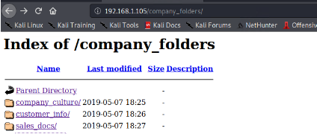
Exploitation: Open Port 80
Continued (images)
03

Slide 10
Exploitation: Directory Traversal
01
02
Tools & Processes
After seeing references to a “secret folder” in the company’s directory, I was able to manually change the URL
Achievements
I was able to navigate to the secret directory from the URL

Slide 11
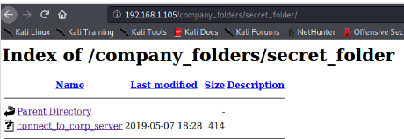
Exploitation: Directory Traversal
03

Slide 12
Exploitation: Brute Force Attack
01
02
Tools & Processes
After exploring the company’s directory in the browser, I assumed Ashton’s username to be just his name, Ashton. I then used the tool Hydra and the RockYou wordlist to crack his password
Achievements
I was able to gain access to the company’s secret directory. From there, I was able to crack Ryan’s hash via CrackStation, and saw instructions for accessing the WebDav

Slide 13
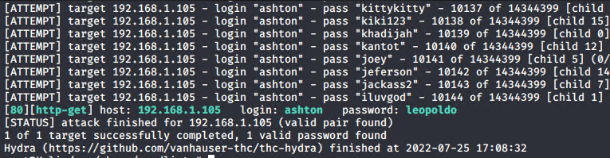
Exploitation: Brute Force Attack
Continued (images)
03

Slide 14
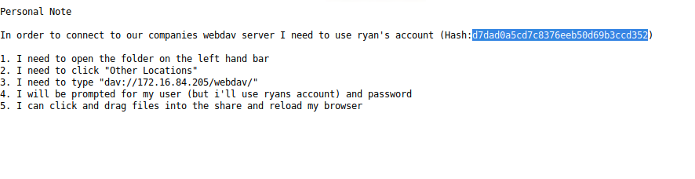
Exploitation: Brute Force Attack
Continued (images)
03

Slide 15
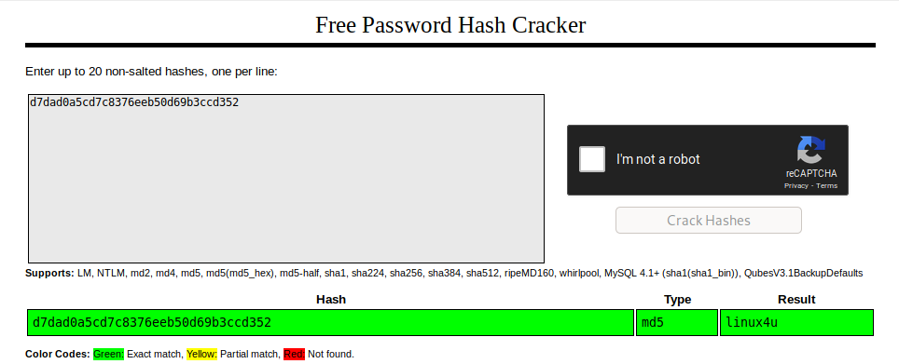
Exploitation: Brute Force Attack
Continued (images)
03

Slide 16
Exploitation: WebDav Attack
01
02
Tools & Processes
I used msfvenom to create a php script that would give me a reverse shell on the target machine and upload it via WebDav
Achievements
I planted a malicious script onto the target machine, that once clicked, would open a reverse shell on the Kali machine

Slide 17
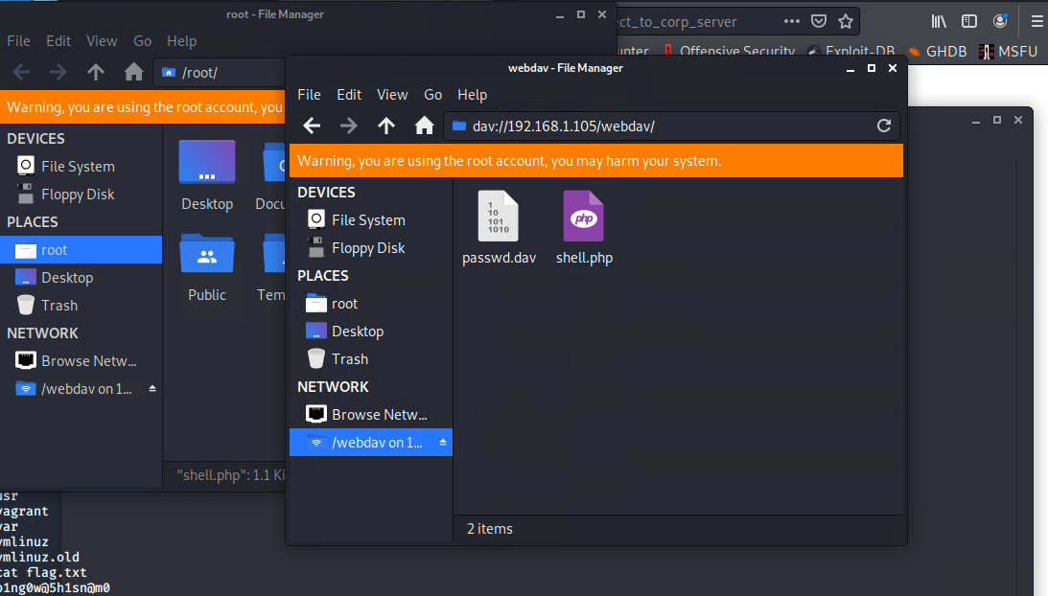
Exploitation: WebDav Attack
03

Slide 18
Exploitation: Reverse Shell Attack
01
02
Tools & Processes
I used Metasploit to exploit the target machine
Achievements
I was able to open a reverse shell and find the flag on the target machine

Slide 19
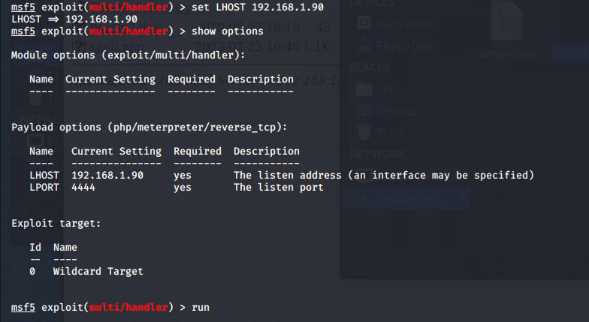
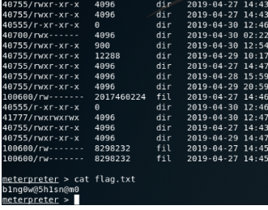
Exploitation: Reverse Shell Attack
03

Slide 20

Blue Team
Log Analysis and Attack Characterization
20

Slide 21

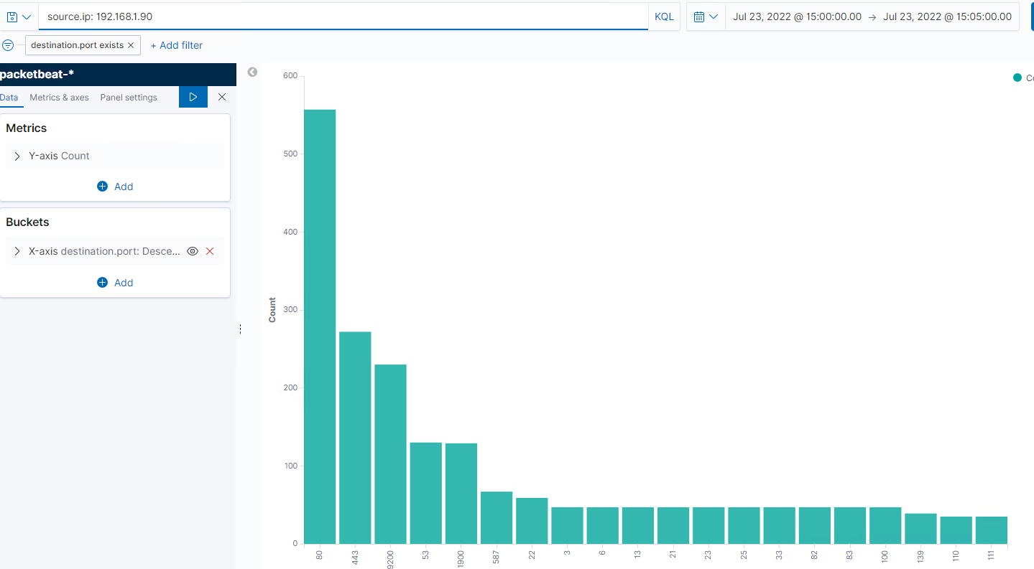
Analysis: Identifying the Port Scan
The port scan occurred at approximately 3PM
46, 067 packets were sent from 192.168.1.90
Since packets were sent to multiple ports, it indicates a port scan
[Insert Here]
Include a screenshot of Kibana logs depicting the port scan.

Slide 22
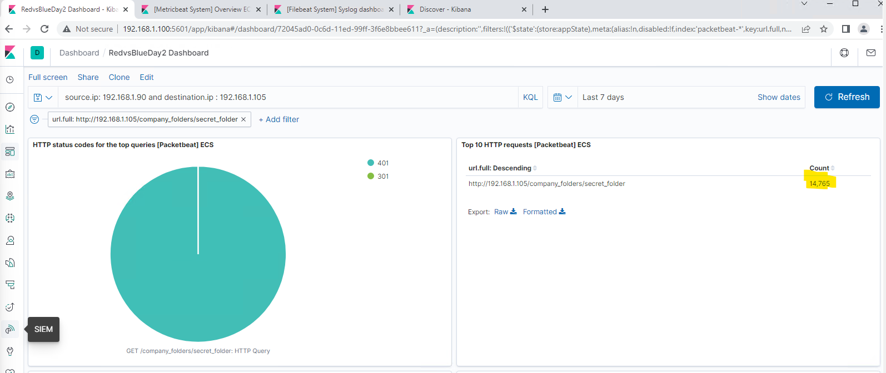
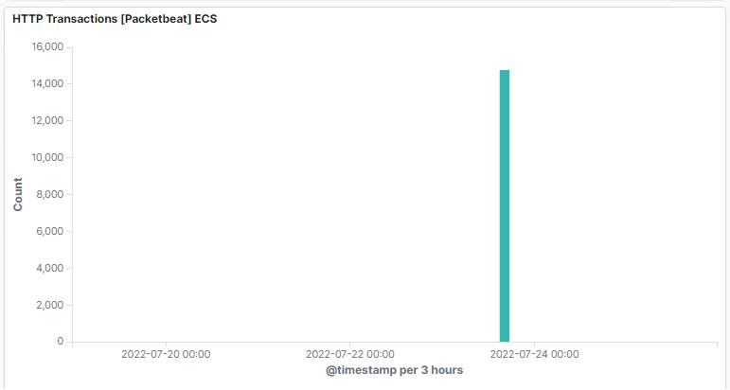
Analysis: Finding the Request for the Hidden Directory
14,765 requests to the secret directory were made around 3PM
Inside the secret directory is the “connect_to_corp_server” directory, which contains directions to accessing WebDav, as well as the hash for Ryan’s password
[Insert Here]

Slide 23
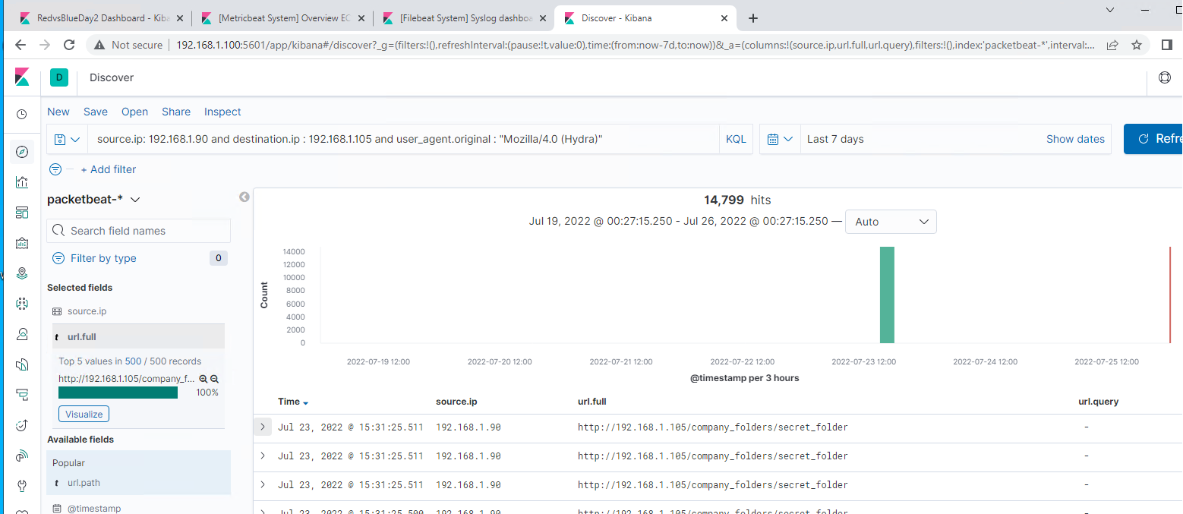
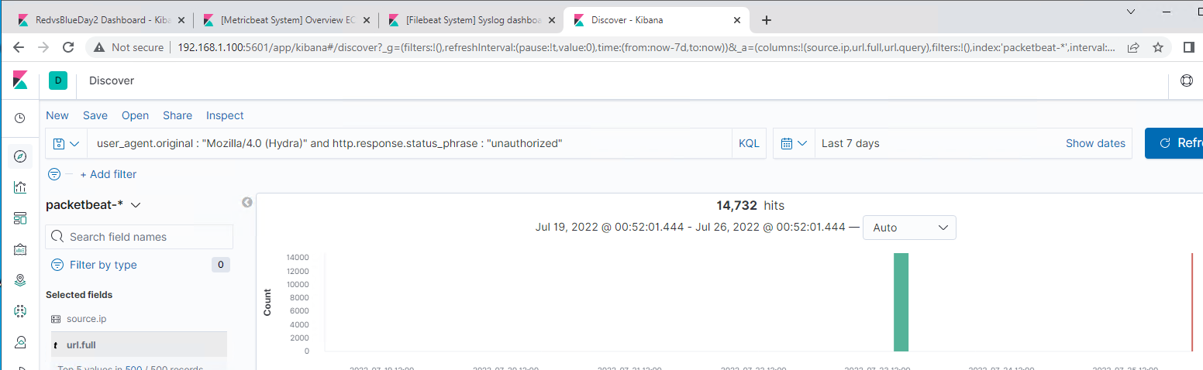
Analysis: Uncovering the Brute Force Attack
14,799 requests were made in the Brute Force Attack using Hydra
14,732 requests were made before the correct password was discovered
[Insert Here]
Include a screenshot of K

Slide 24
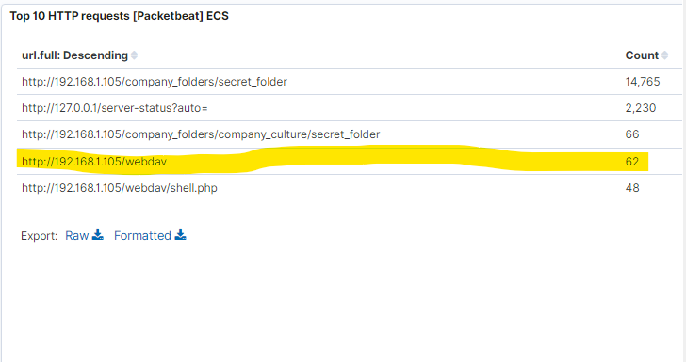
Analysis: Finding the WebDAV Connection
62 requests were made to the WebDav directory
The shell.php file was requested in the WebDav directory
[Insert Here]
Add a screenshot of Kibana logs depicting the WebDAV connection.

Slide 25
Blue Team
Proposed Alarms and Mitigation Strategies
25

Slide 26
Mitigation: Blocking the Port Scan
An alert should be created to notify the SOC team if excessive requests from a single IP is made to multiple ports.
Anything over 10 requests per port should trigger the alert. This number can be adjusted as necessary.
A strong firewall can prevent unauthorized access to a company’s private network. Firewalls can control ports and their visibility, as well as detect scans.

Slide 27
Mitigation: Finding the Request for the Hidden Directory
An alert should be created anytime a request is made to the secret directory.
Only designated personnel should have access from authorized machines. Any unauthorized access should trigger the alert.
The secret directory should be removed from the server. It can be stored in a separate server with firewalls in between the public server and backend data server.

Slide 28
Mitigation: Preventing Brute Force Attacks
An alert should be triggered when there is an excessive amount of failed password attempts.
We would need to establish a baseline of normal successful and unsuccessful login events for the company, and trigger an alert if attempts above that average are met.
Limits should be implemented for failed login attempts before the account is locked out. This can be done company wide. Once the limit is reached, the account can be locked out for a designated period of time, or permanently until verification is completed.

Slide 29
Mitigation: Detecting the WebDAV Connection
An alert should be triggered whenever the WebDAV directory is accessed from a machine outside of the company network.
Establish a whitelist of IPs that should have access to WebDav. Everything else should be blocked by a firewall.

Slide 30
Mitigation: Identifying Reverse Shell Uploads
An alert should be triggered anytime there is traffic over port 4444, the most commonly used port for this type of attack.
We can also set an alert anytime a php file is uploaded to the network.
Removing the ability to upload files over the web interface would prevent a malicious script from entering the network.
Regular training of employees should be conducted to mitigate phishing schemes and the clicking of links that can download payloads.

